Slide 1



LAI SIANGTHO MAPANNA
April 25, 2026 ading Lesson 4

Slide 2

“Banghang hiam cihleh Pasian thu in nungta in vanglian a, langnih a hiam namsau khatpeuh sangin a hiamzaw hi. Lungsim le kha, guh le tang le guhngekte dong pailet in khen tel a, lungsim ngaihsutna le tupna ngimnate zong a thei’tel hi.” (Hebrews 4:12, ZSV)
Notes:
Buscar en biblia-espada

Slide 3


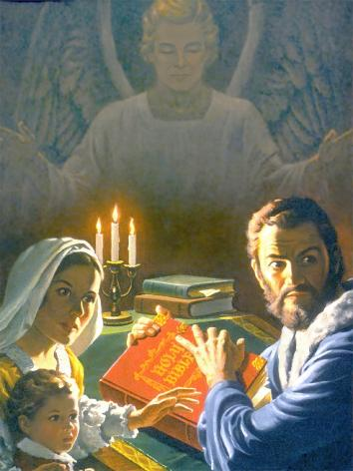
Lai Siangtho pen leitung ah kizuak tam pen laibu ahi a, a nihna a om laibu sangin a kizuakna zah nga in tamzaw hi. Ahi zongin hih pen hun khempeuh ah hih bang hi denlo hi.
Hun khat lai-in Lai Siangtho neihna, simna, ahih keileh tua thu genna nangawn hangin thong kiatna, bawlsiatna, le thahna nangawn kiphukha thei hi.
Pasian' kicing taka a huutna om keileh, Lai Siangtho pen sawtpi pek in mangthang khin ding hi. Bang hang hiam? Hih laibu ah bang thupi lua om hiam, mi tampi in a it mah mah le a huat mahmah uh hihsak hiam?
Lai Siangtho’ gal
Lai Siangtho simdan a dik le a diklo lampite
Lai Siangtho pen bang hiam?
Lai Siangtho simna pan a piang phattuamnate
Lai Siangtho lawmte

Slide 4


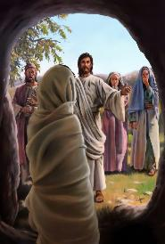


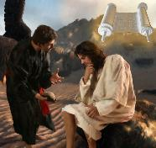
LAI SIANGTHO’ GAL
“Siklukhu khuk bangin hotkhiatna nei unla, Kha Siangtho in a hongpiak Pasian’ thu pen namsau zat bangin na zang un.” (Ephesians 6:17)
Pasian' kammal in a hih theih thute ngaihsun dih in: piansakna le nuntak piakna (Late 33:6), ahihkeileh misite thawhkikna (John 5:28-29).
Lai Siangtho, Pasian' kammal kigelh in bang hih thei hiam? Tua in eite hong dal nading thahatna nei a (Eph. 6:17b) leh ei hong kheltheihna hatna nei hi (Heb. 4:12). Zeisu in khemna panin amah le amah kidal nadingin Lai Siangtho zang hi (Matt 4:4, 7, 10).
Satan in Lai Siangtho vangliatna kheng-in vangliatna a neih lohlam a thei hi. Tua ahih manin, amah in taksa tawh susia dingin hanciam hi. Lai Siangtho kipawlnate in a tul a simin hawm khia pah uh a, amah in a zo kei hi. Tua ciangin amah in a sangzaw thusitna zangin thumanlohna lak sawm hi. Tu-in thudang tuamtuam tawh i hun la-in tua i sim loh nading hanciam hi.
Amah hih bangin khah ding ka hiam? Ka hungeelna sungah Lai Siangtho sim nading hun ka ngah zo kei ding maw? Tua simna in eite hong khel a, i gal lianpen dawi mangpa dodingin thahatna hong pia hi.

Slide 5

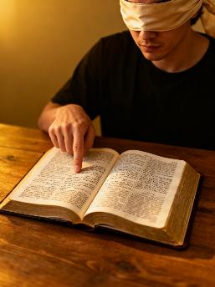



LAI SIANGTHO SIM DAN A DIK LE A DIKLO
“Pasian' thuman a mantakin hilhin, na nasepna-ah maizumna thuakloin, Pasian' pahtakna na ngahtheihna dingin na siam tawpin hanciam in.” (2 Timothy 2:15)
A diklo dante
I muhna tawh a kituak khatpeuh zong in
Tupna bangmah om lo-in, laite mawk telna
A dik dante
Pasian' deihna theih nading hanciam in
A kicianin kisinna bawl in
I deihna lamte tel in, i deih lohna lamte nial ni
Lai khat zong nial kei inla, a vek in sittel in
I Lai Siangtho sinna pen ngaihsutna tawh kisin ding hi-a, ahi zongin Lai Siangtho thupuak dik takin i theih nadingin i ngaihsutna pen Kha Siangtho vangliatna nuai-ah i kipiak ding ahi hi.
Banghang hiam? Banghang hiam cihleh i ngaihsutna pen kicinglo a, hun khempeuh ah muanhuai denlo hi. Tua manin, Lai Siangtho i sin ciangin a Gelhpa’ pilna i zon ding kisam hi.

Slide 6



LAI SIANGTHO PEN BANG HIAM?
I khawtang nuntakna sungah, Khristian pawlpi sungte nangawn ah, thutak pen dinmun zui-in kilaih thei hi, hun khempeuh ah a kikhel ngeilo thutak om lo hi, kici-in upna khat om hi.
“Na thubulpi thumanna hi-a, a man mahmah, nangmah biakna ngeina kipte khempeuh a tawntungin kip paisuak hi.”
(Late 119:160 ZIV)
Ahi zongin, Lai Siangtho—Pasian’ kammal ahihna tawh— thuman thutak nei hi ci-in kigen hi (Late 119:160; John 17:17; James 1:18). Ama pen siangtho hi ci-in kigen a, mihingte’ khemna panin dalna lum ahi hi (Paunak 30:5). Tua sungah eima thutak khatpeuh i behlap leh, Pasian mai-ah zuaugen mite i kici thei hi (Paunak 30:6).
Thugen khempeuh, thuman khempeuh, Lai Siangtho tawh sitcian’ kul hi. Eite’n thuman i sak thute le Lai Siangtho in a gen thute a kikalh ciangin, thupiang thei nih a om hi: eite’ khialhna ahihkeileh Lai Siangtho pen a diklo in telkhehna hithei hi.

Slide 7






LAI SIANGTHO SIMNA PAN A PIANG PHATTUAMNATE
“Nangma tungah kong khialh lohna dingin ka lungsim sungah nangma thu ka khol hi.” (Late 119:11)
Lai Siangtho a langpan mahmah mite nangawn in a nial zawh loh uh thukhat in, mite a khelthei a thahatna ahi hi. Paul in tua pen thahatna lianpi a nei namsau khat tawh teh hi.
Tua in ei le ei i hihna taktak bangin i kimu sak hi (Heb. 4:12)
Tua in mawhna panin eite hong dal hi (Late 119:11)
I kha ading an ahi hi (Jer. 15:16)
Tua in kha lam ah hong khangto sak hi (1 Peter 2:2)
Amah in nuntakna hongpia hi (John 6:63)
Lai Siangtho bangin eite tungah thupitna a pia zo laibu dang a om kei hi. Ama thuhilhnate i nuntakna ah i zuih ding i khensat ciangin, i nuntakna a hoih lamah a kilep hi.
Lungsim kihong tawh sim-in, Kha Siangtho' vaksakna Pasian kiangah i nget ciangin, i nuntakna kikhel hi.

Slide 8

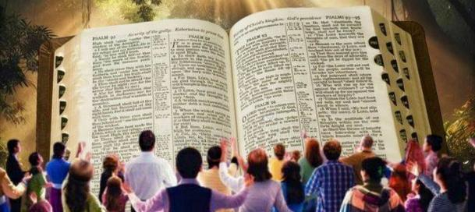
“Note kiangah Pasian' thu ka hong gen uh ciangin no thu um mite sungah ama thu tawh kisai-in Pasian in na hong sem ahih manin kote' thugente pen Pasian' thu taktak ahih mah bangin kote' thugenna na zak uh ciangin mihing' thu bangin ngaihsun loin Pasian' thu taktak mahin hong sang na hih manun, hih thu hangin zong Pasian' tungah ka lungdamna uh ka ko uh hi.” (1 Thessalonika 2:13)
LAI SIANGTHO LAWMTE
Hih bangin Lai Siangtho i san ciangin …
Tua in Pasian tawh i kizopna dinmun hong lak hi
Tua in tua kizopna bangci khauhsak ding hiam cih eite hong hilh hi
Eite in damdam in kikhelna khat i nei to hi
Zeisu kiangah i naih hi
Hih in hotkhiatna ding pilna hong pia hi
Thuman theihna sungah i khangto semsem hi
I upna khangto-in thahat semsem hi
I lametna nei hi
Ahoih zaw, a tawntung, a nuam mahmah nuntakna in ngak hi cih i thei hi
Lai Siangtho it’te in Pasian' Kammal nung ahihna phawk gige-in a naih uh hi. (1 Thessalonika 2:13). Ahih hangin tua upna bangci-in ka ngah thei ding hiam?
Paul in hih nadingin kha lam khentat theihna, tua in kha lam thute teltheihna i kisapna thu hong gen hi. (1 Corinth 2:14). Tua ahih manin, Lai Siangtho sunga Pasian' thupuak khenteltheihna pen i sungah Kha Siangtho nasepna ahi hi.

Slide 9

“Lai Siangtho in thuman pen olno tak le mihing lungtang' kisapna le deihnate tawh kituak kician takin phuankhia a, tua in pilna sang mah mah nei mite lamdang sakna le lunggulhna pia a, tua mah hun ah mi niamte le pilna neilote nangawn in hotkhiatna lampi a muh theih nading huh hi. Ahizongin hih thuman olno-a kigen kuate in, thute sang mahmah, thuk mahmah, le mihingte' theihna tawh kiteltheilo khop-in thuk mahmah ahih manin, Pasian in a gen khit ciangin bek i sang thei hi. […] Lai Siangtho a kan semsem le, nungta Pasian' kammal ahihna a upna a thuk semsem a, mihingte' ngaihsutna in Pasian' kilatna thupitna mai-ah kun hi.”
EGW (Steps to Christ, p. 107)

